Slide 1

MTHM017 Advanced Topics Workshop D
Dr John T Bruun

Slide 2
Workshop Task
This week we are looking classification with Decision Trees and Support Vector Machine (SVP) analysis methods.
We will focus on running Rmarkdown code in this lab.
and can share the equivalent in Python if you are interested after this.

Slide 3
Decision Trees
Decision trees are simple and intuitive predictive models, making them a popular choice when decision rules are required, for example in medicine. A decision tree is constructed as follows:
1. Find the yes/no rule that best splits the data with respect to *one* of the features.
2. The best split is the one that produces the most homogeneous groups; found by maximising information gain/lowering entropy.
3. Repeat steps 1 to 2 until all data are correctly classified or some stopping rule reached.
In this exercise we will build a decision tree to classify the flowers in the *iris* dataset into one of the following classes: setosa, versicolor, virginica.

Slide 4
Decision Trees
We first split the dataset into a training dataset and a test dataset, then we use the training dataset to build the decision tree, and the test dataset to evaluate the performance of the built tree.
In R the `C50` package is needed to build a decision tree. The `x` argument of the `C5.0` function takes the dataset with the possible predictors, while the `y` argument has the list of labels. We can plot the tree by simply using the `plot` function on the outcome.
In Python we use the `tree.DecisionTreeClassifier` function of the `tree` package to build the decision tree. To draw the decision tree we use the `graphviz` package of Python.
Finally, in both R and Python the `predict` function can be used to evaluate the performance of the fitted tree, which predicts the labels of the observations in the test dataset.

Slide 5
Decision Trees
library(C50)
library(caret)
# Split train/test data
ii <- createDataPartition(iris[, 5], p=.7, list=F) ## returns indices for train data
xTrain <- iris[ii, 1:4]; yTrain <- iris[ii, 5]
xTest <- iris[-ii, 1:4]; yTest <- iris[-ii, 5]
# Fit and plot model
mdl <- C5.0(x=xTrain, y=yTrain)
plot(mdl)
# Test model on testing data
yTestPred <- predict(mdl, newdata=xTest)
confusionMatrix(yTestPred, yTest) # predicted/true
Decision trees are easy to explain to non-experts and can be directly used to generate rules. Furthermore they are computationally inexpensive to train, evaluate and store, they can handle both categorical and continuous data. They are also robust to outliers.
However decision trees can easily overfit the data, and their predictive accuracy can be quite poor. They can only have linear decision boundaries, and small changes in the data may lead to a completely different tree.

Slide 6
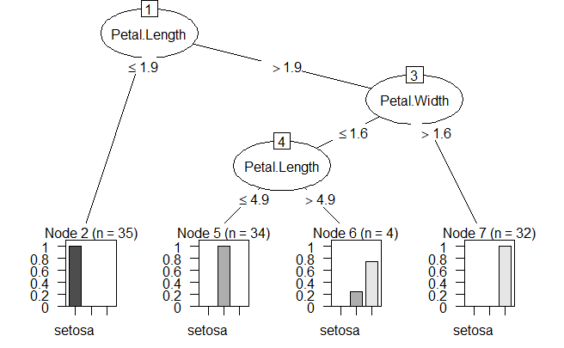
Decision Trees
This gives the output

Slide 7
Decision Trees: This gives the output
Confusion Matrix and Statistics
Reference
Prediction setosa versicolor virginica
setosa 15 0 0
versicolor 0 13 0
virginica 0 2 15
Overall Statistics
Accuracy : 0.9556
95% CI : (0.8485, 0.9946)
No Information Rate : 0.3333
P-Value [Acc > NIR] : < 2.2e-16
Kappa : 0.9333
Mcnemar's Test P-Value : NA
Statistics by Class:
Class: setosa Class: versicolor Class: virginica
Sensitivity 1.0000 0.8667 1.0000
Specificity 1.0000 1.0000 0.9333
Pos Pred Value 1.0000 1.0000 0.8824
Neg Pred Value 1.0000 0.9375 1.0000
Prevalence 0.3333 0.3333 0.3333
Detection Rate 0.3333 0.2889 0.3333
Detection Prevalence 0.3333 0.2889 0.3778
Balanced Accuracy 1.0000 0.9333 0.9667

Slide 8
Support Vector Machines
The rationale behind a maximal margin classifier is to find an optimal line/hyperplane that maximises the margin, that is, the distance between data points of both classes. This turns out to be a rather straightforward optimisation problem.
But what do we do if there isn’t a 'clean' separating line between the classes?
Support vector classifiers (SVC) were developed that use a soft margin approach. The hyperplane is placed in a way that it correctly classifies most of the data points.
In reality, we face even more complex data sets where a hyperplane would never do a good job at separating the two classes. A non-linear boundary in this case can do the job.
Support vector machines are a generalisation of support vector classifiers that make use of kernels to map the original feature set to a higher dimensional space where classes are linearly separable. This might sound counter-intuitive, as increasing the dimensionality of the problem is undesirable. However, the kernel trick enable us to work in an implicit feature space, such that the data is never explicitly expressed in higher dimensions. Think about kernels as generalised distance measures.

Slide 9
Support Vector Machines
The type of kernel is a hyperparameter that we can infer using cross-validation. However, in `caret`, each kernel is defined as a separate model, and thus the cross-validation loop need to be written manually rather than relying on the `trainControl` function.
(In python: This is not a problem in `scikit-learn` where SVMs are implemented as a generic function that takes kernel as an input).
Note: SVMs are inherently binary classifiers. The most common ways to deal with multi-class problems is by building several *one-versus-all* or *one-versus-one* classifiers.
In `R` we use the `train` function with `svm_` method to fit a support vector machine, where `_` is the kernel we want to use. For example `svmLinear` is a support vector machine with a linear kernel, `svmRadial` is s SVM with radial basis kernel, while `svmPoly` uses a polynomial kernel.
First we fit a SVM to the iris dataset using a linear kernel.
The following code requires the kernlab package in R

Slide 10
Support Vector Machines
library(kernlab)
# library(tidyverse)
mdl <- train(x=xTrain,y=yTrain, method='svmLinear')
print(mdl)
# Test model on testing data
yTestPred <- predict(mdl, newdata=xTest)
# yTestPred <- mdl %>% predict(xTest)
confusionMatrix(yTestPred, yTest) # predicted/true

Slide 11
Support Vector Machines: output
Support Vector Machines with Linear Kernel
105 samples
4 predictor
3 classes: 'setosa', 'versicolor', 'virginica'
No pre-processing
Resampling: Bootstrapped (25 reps)
Summary of sample sizes: 105, 105, 105, 105, 105, 105, ...
Resampling results:
Accuracy Kappa
0.9700175 0.9542967
Tuning parameter 'C' was held constant at a value of 1
Confusion Matrix and Statistics
Reference
Prediction setosa versicolor virginica
setosa 15 0 0
versicolor 0 15 1
virginica 0 0 14
Overall Statistics
Accuracy : 0.9778
95% CI : (0.8823, 0.9994)

Slide 12
Support Vector Machines
By default the SVM linear classifier is built using C = 1. It’s possible to automatically compute SVM for different values of C and to choose the optimal one that maximise the model cross-validation accuracy. In the following example we use a 5-fold cross validation, and try 20 different C values between 0 and 2.
mdl <- train(x=xTrain,y=yTrain, method = "svmLinear",
trControl = trainControl("cv", number = 5),
tuneGrid = expand.grid(C = seq(0, 2, length = 20)))
# Plot model accuracy vs different values of Cost
plot(mdl)
# Print the best tuning parameter C that maximises model accuracy
mdl$bestTune
# Test model on testing data
yTestPred <- predict(mdl, newdata=xTest)
confusionMatrix(yTestPred, yTest) # predicted/true

Slide 13
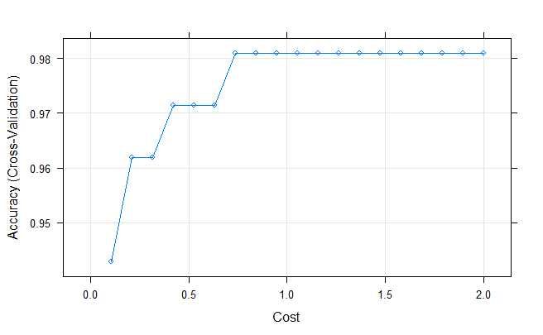
C
<dbl>
8 0.7368421

Slide 14
Support Vector Machines: output
Confusion Matrix and Statistics
Reference
Prediction setosa versicolor virginica
setosa 15 0 0
versicolor 0 15 1
virginica 0 0 14
Overall Statistics
Accuracy : 0.9778
95% CI : (0.8823, 0.9994)

Slide 15
Support Vector Machines
Note that in some cases we might want to normalise the variables to make their scale comparable. This is automatically done before building the SVM classifier by setting the option `preProcess = c("center","scale")`.
mdl <- train(x=xTrain,y=yTrain, method='svmPoly')
print(mdl)
mdl$bestTune
# Test model on testing data
yTestPred <- predict(mdl, newdata=xTest)
confusionMatrix(yTestPred, yTest) # predicted/true
Accuracy was used to select the optimal model using the largest value.
The final values used for the model were degree = 3, scale = 0.1 and C = 1.
Confusion Matrix and Statistics
Reference
Prediction setosa versicolor virginica
setosa 15 0 0
versicolor 0 15 1
virginica 0 0 14
Overall Statistics
Accuracy : 0.9778
95% CI : (0.8823, 0.9994)

Slide 16
Extra Tasks: Download the gene expression and wine datasets from the ELE page.
1. For the gene expression dataset use any of the techniques described above (feel free to try and compare all of them) to build a binary classifier to classify the B- and T-cell leukaemia patients. Compute the predictive performance measures.
2. For the wine dataset use any of the techniques described above (feel free to try and compare all of them) and build a multi-label classifier to classify the three different types of wine. Compute the predictive performance measures.

Slide 17
Workshop Task
The task you have is to Build a classifier of breast cancer malignancy.
Breakout into teams of about 6. You have an hour, and then report back.
There is a lot to run and assess. Create team pairs of investigators to look at the following:
Number of variables: Explore the performance of the classifier by varying the number of variables V1, … V30 used in the logistic regression function.
Training data set size: To test the model efficacy, since we only have one dataset, to test model performance create a ‘hold-out’ sample and develop the model on the remaining training data set. To do this randomly split to data, and build the model on {65%, 75%, 85%} of available, and test the model on the remaining {35%, 25%, 15%}.
Outcome:
Put together a table of results explaining the confusion matrix / accuracy results.
With this table jointly produce a 1 – page summary in a form suitable to explain the results to a medical clinician. How well does it work and what are any limitations?

